Slide 1
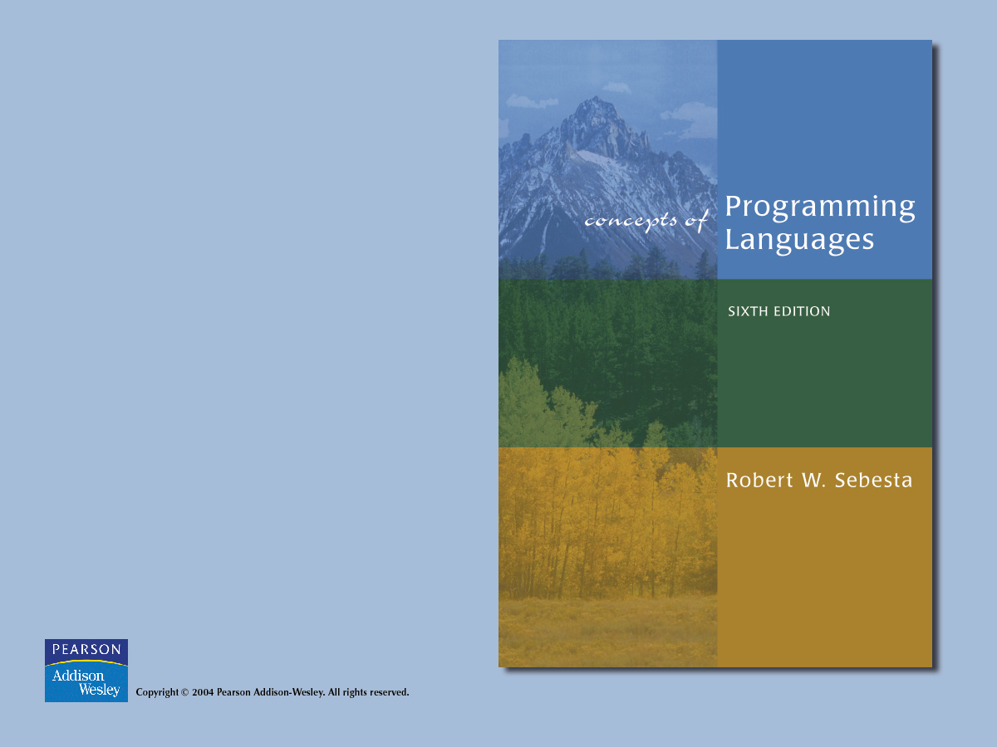
Chapter 6
Data Types

Slide 2

Chapter 6 Topics
Introduction
Primitive Data Types
Character String Types
User-Defined Ordinal Types
Array Types
Associative Arrays
Record Types
Union Types
Pointer Types

Slide 3
Introduction
A data type defines a collection of data objects and a set of predefined operations on those objects
Evolution of data types:
  FORTRAN I (1957) - INTEGER, REAL, arrays
  Ada (1983) - User can create a unique type for every category of variables in the problem space and have the system enforce the types
Definition: A descriptor is the collection of the attributes of a variable

Slide 4
Introduction
Design issues for all data types:
  1. What is the syntax of references to variables?
  2. What operations are defined and how are they specified?

Slide 5
Primitive Data Types
Those not defined in terms of other data types
1. Integer
  Almost always an exact reflection of the hardware, so the mapping is trivial
  There may be as many as eight different integer types in a language

Slide 6
Primitive Data Types
2. Floating Point
  Model real numbers, but only as approximations
  Languages for scientific use support at least two floating-point types; sometimes more
  Usually exactly like the hardware, but not always

Slide 7
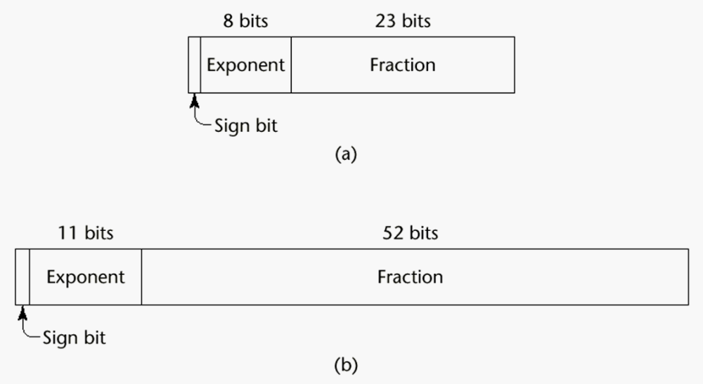
IEEE Floating Point Formats

Slide 8
Primitive Data Types
3. Decimal
  For business applications (money)
  Store a fixed number of decimal digits (coded)
  Advantage: accuracy
  Disadvantages: limited range, wastes memory

Slide 9
Primitive Data Types
4. Boolean
  Could be implemented as bits, but often as bytes
  Advantage: readability
5. Character
  Stored as numeric codings (e.g., ASCII, Unicode)

Slide 10
Character String Types
Values are sequences of characters
Design issues:
  1. Is it a primitive type or just a special kind of array?
  2. Is the length of objects static or dynamic?

Slide 11
Character String Types
Operations:
  Assignment
  Comparison (=, >, etc.)
  Catenation
  Substring reference
  Pattern matching

Slide 12
Character String Types
Examples:
  Pascal
    Not primitive; assignment and comparison only (of packed arrays)
  Ada, FORTRAN 90, and BASIC
    Somewhat primitive
    Assignment, comparison, catenation, substring reference
    FORTRAN has an intrinsic for pattern matching
  e.g. (Ada)
N := N1 & N2 (catenation)
N(2..4) (substring reference)

Slide 13
Character String Types
C and C++
  Not primitive
  Use char arrays and a library of functions that provide operations
SNOBOL4 (a string manipulation language)
  Primitive
  Many operations, including elaborate pattern matching

Slide 14
Character String Types
Perl and JavaScript
  Patterns are defined in terms of regular expressions
  A very powerful facility
  e.g.,
/[A-Za-z][A-Za-z\d]+/
Java - String class (not arrays of char)
  Objects cannot be changed (immutable)
  StringBuffer is a class for changeable string objects

Slide 15
Character String Types
String Length Options:
  1. Static - FORTRAN 77, Ada, COBOL
  e.g. (FORTRAN 90)
CHARACTER (LEN = 15) NAME;
  2. Limited Dynamic Length - C and C++ actual length is indicated by a null character
  3. Dynamic - SNOBOL4, Perl, JavaScript

Slide 16
Character String Types
Evaluation
  Aid to writability
  As a primitive type with static length, they are inexpensive to provide--why not have them?
  Dynamic length is nice, but is it worth the expense?

Slide 17
Character String Types
Implementation:
  Static length - compile-time descriptor
  Limited dynamic length - may need a run-time descriptor for length (but not in C and C++)
  Dynamic length - need run-time descriptor; allocation/deallocation is the biggest implementation problem

Slide 18
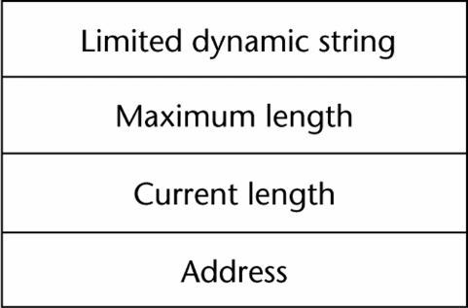
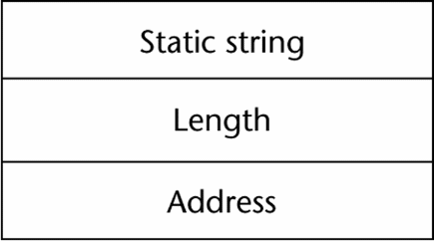
Character String Types
Compile-time descriptor for static strings
Run-time descriptor for limited dynamic strings

Slide 19
User-Defined Ordinal Types
An ordinal type is one in which the range of possible values can be easily associated with the set of positive integers

Slide 20
User-Defined Ordinal Types
1. Enumeration Types - one in which the user enumerates all of the possible values, which are symbolic constants
Design Issue: Should a symbolic constant be allowed to be in more than one type definition?

Slide 21
User-Defined Ordinal Types
Examples:
  Pascal - cannot reuse constants; they can be used for array subscripts, for variables, case selectors; NO input or output; can be compared
  Ada - constants can be reused (overloaded literals); distinguish with context or type_name ‘ (one of them); can be used as in Pascal; CAN be input and output
  C and C++ - like Pascal, except they can be input and output as integers
  Java does not include an enumeration type, but provides the Enumeration interface

Slide 22
User-Defined Ordinal Types
Evaluation (of enumeration types):
  a. Aid to readability--e.g. no need to code a color as a number
  b. Aid to reliability--e.g. compiler can check:
    i. operations (don’t allow colors to be added)
    ii. ranges of values (if you allow 7 colors and code them as the integers, 1..7, then 9 will be a legal integer (and thus a legal color))

Slide 23
User-Defined Ordinal Types
2. Subrange Type
  An ordered contiguous subsequence of an ordinal type
Design Issue: How can they be used?

Slide 24
User-Defined Ordinal Types
Examples:
  Pascal - Subrange types behave as their parent types; can be used as for variables and array indices
e.g. type pos = 0 .. MAXINT;

Slide 25
User-Defined Ordinal Types
Examples of Subrange Types (continued)
  Ada - Subtypes are not new types, just constrained existing types (so they are compatible); can be used as in Pascal, plus case constants
e.g.
subtype POS_TYPE is
INTEGER range 0..INTEGER'LAST;

Slide 26
User-Defined Ordinal Types
Evaluation of subrange types:
  Aid to readability
  Reliability - restricted ranges add error detection

Slide 27
User-Defined Ordinal Types
Implementation of user-defined ordinal types
  Enumeration types are implemented as integers
  Subrange types are the parent types with code inserted (by the compiler) to restrict assignments to subrange variables

Slide 28
Arrays
An array is an aggregate of homogeneous data elements in which an individual element is identified by its position in the aggregate, relative to the first element.

Slide 29
Arrays
Design Issues:
  1. What types are legal for subscripts?
  2. Are subscripting expressions in element
  references range checked?
  3. When are subscript ranges bound?
  4. When does allocation take place?
  5. What is the maximum number of subscripts?
  6. Can array objects be initialized?
  7. Are any kind of slices allowed?

Slide 30
Arrays
Indexing is a mapping from indices to elements
map(array_name, index_value_list) → an element
Index Syntax
  FORTRAN, PL/I, Ada use parentheses
  Most other languages use brackets

Slide 31
Arrays
Subscript Types:
  FORTRAN, C - integer only
  Pascal - any ordinal type (integer, boolean, char, enum)
  Ada - integer or enum (includes boolean and char)
  Java - integer types only

Slide 32
Arrays
Categories of arrays (based on subscript binding and binding to storage)
  1. Static - range of subscripts and storage bindings are static
  e.g. FORTRAN 77, some arrays in Ada
  Advantage: execution efficiency (no allocation or deallocation)

Slide 33
Arrays
2. Fixed stack dynamic - range of subscripts is statically bound, but storage is bound at elaboration time
  e.g. Most Java locals, and C locals that are not static
  Advantage: space efficiency

Slide 34
Arrays
3. Stack-dynamic - range and storage are dynamic, but fixed from then on for the variable’s lifetime
  e.g. Ada declare blocks
declare
STUFF : array (1..N) of FLOAT;
begin
...
end;
  Advantage: flexibility - size need not be known until the array is about to be used

Slide 35
Arrays
4. Heap-dynamic - subscript range and storage bindings are dynamic and not fixed
  e.g. (FORTRAN 90)
INTEGER, ALLOCATABLE, ARRAY (:,:) :: MAT
(Declares MAT to be a dynamic 2-dim array)
ALLOCATE (MAT (10,NUMBER_OF_COLS))
(Allocates MAT to have 10 rows and
NUMBER_OF_COLS columns)
DEALLOCATE MAT
(Deallocates MAT’s storage)

Slide 36
Arrays
4. Heap-dynamic (continued)
  In APL, Perl, and JavaScript, arrays grow and shrink as needed
  In Java, all arrays are objects (heap-dynamic)

Slide 37
Arrays
Number of subscripts
  FORTRAN I allowed up to three
  FORTRAN 77 allows up to seven
  Others - no limit
Array Initialization
  Usually just a list of values that are put in the array in the order in which the array elements are stored in memory

Slide 38
Arrays
Examples of array initialization:
  1. FORTRAN - uses the DATA statement, or put the values in / ... / on the declaration
  2. C and C++ - put the values in braces; can let the compiler count them
  e.g.
  int stuff [] = {2, 4, 6, 8};

Slide 39
Arrays
Examples of array initialization:
  3. Ada - positions for the values can be specified
  e.g.
  SCORE : array (1..14, 1..2) :=
  (1 => (24, 10), 2 => (10, 7),
  3 =>(12, 30), others => (0, 0));
  4. Pascal does not allow array initialization

Slide 40
Arrays
Array Operations
  1. APL - many, see book (p. 240-241)
  2. Ada
  Assignment; RHS can be an aggregate constant or an array name
  Catenation; for all single-dimensioned arrays
  Relational operators (= and /= only)
  3. FORTRAN 90
  Intrinsics (subprograms) for a wide variety of array operations (e.g., matrix multiplication, vector dot product)

Slide 41
Arrays
Slices
  A slice is some substructure of an array; nothing more than a referencing mechanism
  Slices are only useful in languages that have array operations

Slide 42
Arrays
Slice Examples:
  1. FORTRAN 90
INTEGER MAT (1:4, 1:4)
MAT(1:4, 1) - the first column
MAT(2, 1:4) - the second row

Slide 43
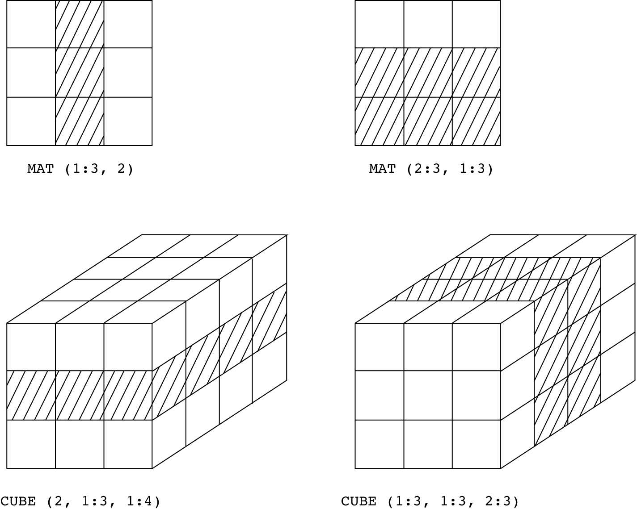
Example Slices in FORTRAN 90

Slide 44
Arrays
Slice Examples:
  2. Ada - single-dimensioned arrays only
  LIST(4..10)

Slide 45
Arrays
Implementation of Arrays
  Access function maps subscript expressions to an address in the array
  Row major (by rows) or column major order (by columns)

Slide 46
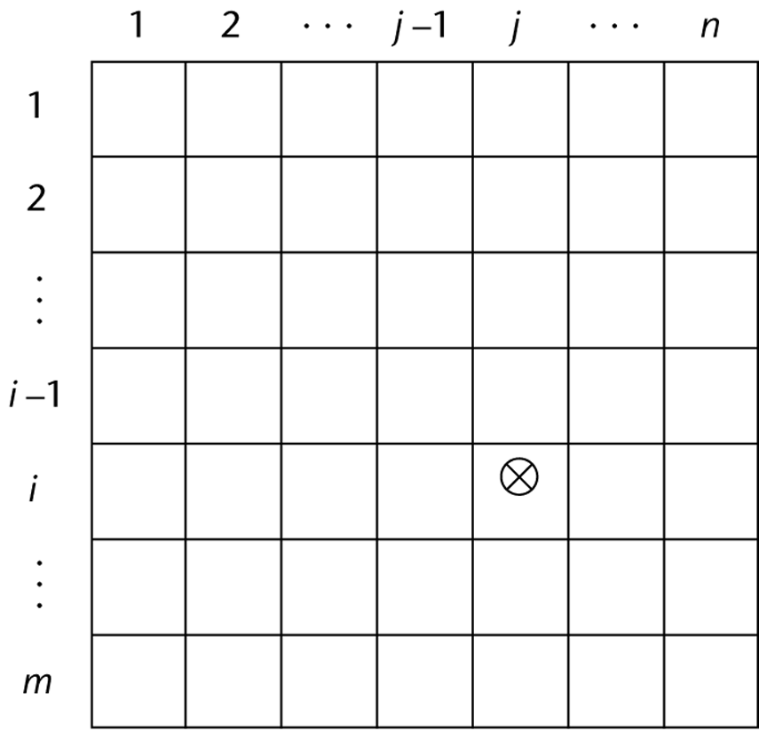
Locating an Element

Slide 47
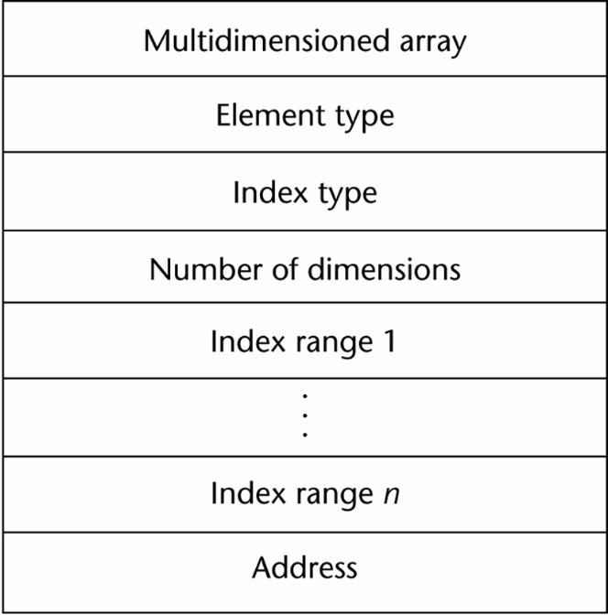
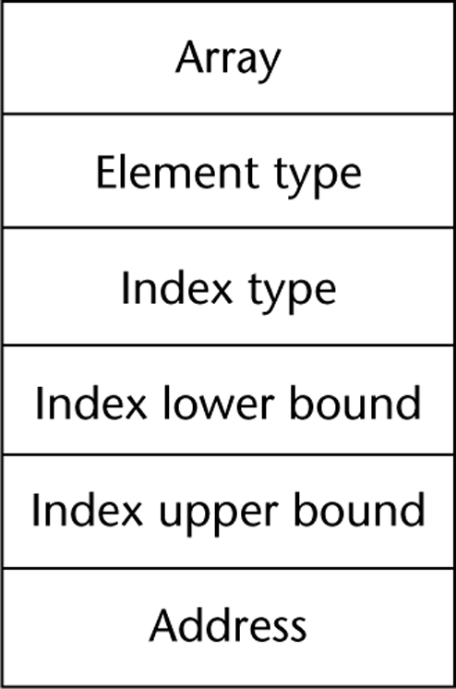
Compile-Time Descriptors
Single-dimensioned array
Multi-dimensional array

Slide 48
Associative Arrays
An associative array is an unordered collection of data elements that are indexed by an equal number of values called keys
Design Issues:
  1. What is the form of references to elements?
  2. Is the size static or dynamic?

Slide 49
Associative Arrays
Structure and Operations in Perl
  Names begin with %
  Literals are delimited by parentheses
  e.g.,
  %hi_temps = ("Monday" => 77,
  "Tuesday" => 79,…);
  Subscripting is done using braces and keys
  e.g.,
  $hi_temps{"Wednesday"} = 83;
  Elements can be removed with delete
  e.g.,
  delete $hi_temps{"Tuesday"};

Slide 50
Records
A record is a possibly heterogeneous aggregate of data elements in which the individual elements are identified by names
Design Issues:
  1. What is the form of references?
  2. What unit operations are defined?

Slide 51
Records
Record Definition Syntax
  COBOL uses level numbers to show nested records; others use recursive definition
Record Field References
  1. COBOL
  field_name OF record_name_1 OF ... OF record_name_n
  2. Others (dot notation)
  record_name_1.record_name_2. ... record_name_n.field_name

Slide 52
Records
Fully qualified references must include all record names
Elliptical references allow leaving out record names as long as the reference is unambiguous
Pascal provides a with clause to abbreviate references

Slide 53
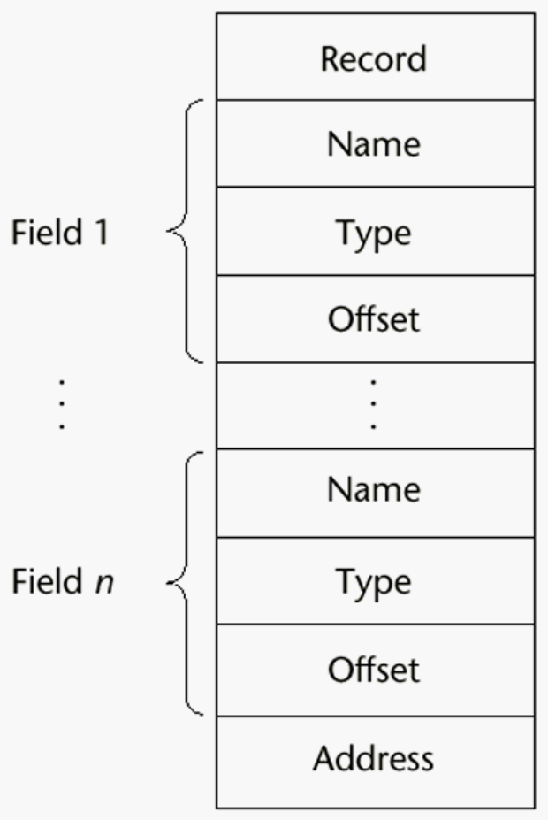
Records
A compile-time descriptor for a record

Slide 54
Records
Record Operations
  1. Assignment
  Pascal, Ada, and C allow it if the types are identical
  In Ada, the RHS can be an aggregate constant
  2. Initialization
  Allowed in Ada, using an aggregate constant

Slide 55
Records
Record Operations (continued)
  3. Comparison
  In Ada, = and /=; one operand can be an aggregate constant
  4. MOVE CORRESPONDING
  In COBOL - it moves all fields in the source record to fields with the same names in the destination record

Slide 56
Records
Comparing records and arrays
  1. Access to array elements is much slower than access to record fields, because subscripts are dynamic (field names are static)
  2. Dynamic subscripts could be used with record field access, but it would disallow type checking and it would be much slower

Slide 57
Unions
A union is a type whose variables are allowed to store different type values at different times during execution
Design Issues for unions:
  1. What kind of type checking, if any, must be done?
  2. Should unions be integrated with records?

Slide 58
Unions
Examples:
  1. FORTRAN - with EQUIVALENCE
  No type checking
  2. Pascal - both discriminated and nondiscriminated unions
e.g. type intreal =
record tagg : Boolean of
true : (blint : integer);
false : (blreal : real);
end;
  Problem with Pascal’s design: type checking is ineffective

Slide 59
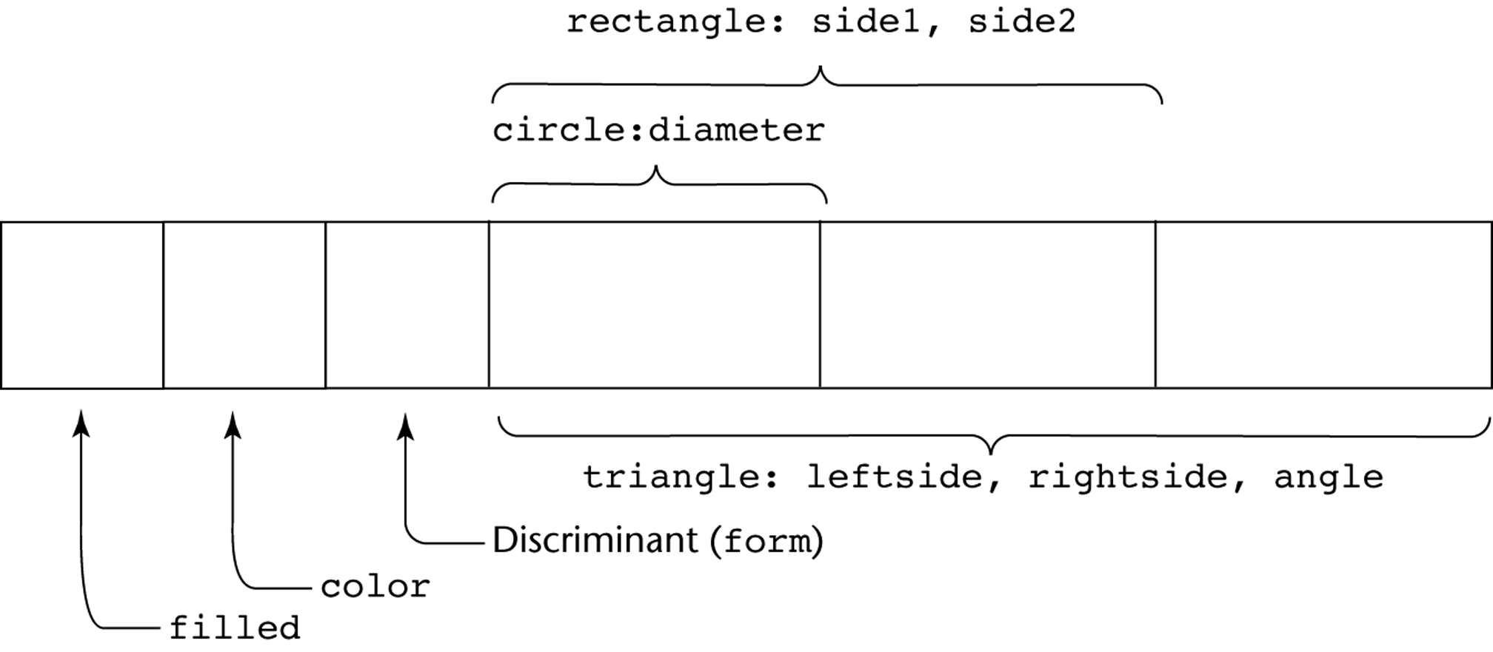
Unions
A discriminated union of three shape variables

Slide 60
Unions
Reasons why Pascal’s unions cannot be type checked effectively:
  a. User can create inconsistent unions (because the tag can be individually assigned)
var blurb : intreal;
x : real;
blurb.tagg := true; { it is an integer }
blurb.blint := 47; { ok }
blurb.tagg := false; { it is a real }
x := blurb.blreal; { assigns an integer to real }

Slide 61
Unions
Reasons why Pascal’s unions cannot be type checked effectively (continued):
  b. The tag is optional!
  Now, only the declaration and the second and last assignments are required to cause trouble

Slide 62
Unions
Examples (continued):
3. Ada - discriminated unions
  Reasons they are safer than Pascal:
  a. Tag must be present
  b. It is impossible for the user to create an inconsistent union (because tag cannot be assigned by itself--All assignments to the union must include the tag value, because they are aggregate values)

Slide 63
Unions
Examples (continued):
  5. C and C++ - free unions (no tags)
  Not part of their records
  No type checking of references
  6. Java has neither records nor unions
Evaluation - potentially unsafe in most languages (not Ada)

Slide 64
Sets
A set is a type whose variables can store unordered collections of distinct values from some ordinal type
Design Issue:
  What is the maximum number of elements in any set base type?

Slide 65
Pointers
Problems with pointers:
  1. Dangling pointers (dangerous)
  A pointer points to a heap-dynamic variable that has been deallocated
  Creating one (with explicit deallocation):
  a. Allocate a heap-dynamic variable and set a pointer to point at it
  b. Set a second pointer to the value of the first pointer
  c. Deallocate the heap-dynamic variable, using the first pointer

Slide 66
Pointers
Problems with pointers (continued):
  2. Lost Heap-Dynamic Variables ( wasteful)
  A heap-dynamic variable that is no longer referenced by any program pointer
  Creating one:
  a. Pointer p1 is set to point to a newly created heap-dynamic variable
  b. p1 is later set to point to another newly created heap-dynamic variable
  The process of losing heap-dynamic variables is called memory leakage

Slide 67
Pointers
Examples:
  1. Pascal: used for dynamic storage management only
  Explicit dereferencing (postfix ^)
  Dangling pointers are possible (dispose)
  Dangling objects are also possible

Slide 68
Pointers
Examples (continued):
  2. Ada: a little better than Pascal
  Some dangling pointers are disallowed because dynamic objects can be automatically deallocated at the end of pointer's type scope
  All pointers are initialized to null
  Similar dangling object problem (but rarely happens, because explicit deallocation is rarely done)

Slide 69
Pointers
Examples (continued):
  3. C and C++
  Used for dynamic storage management and addressing
  Explicit dereferencing and address-of operator
  Domain type need not be fixed (void *)
  void * - Can point to any type and can be type checked (cannot be dereferenced)

Slide 70
Pointers
  3. C and C++ (continued)
  Can do address arithmetic in restricted forms, e.g.:
float stuff[100];
float *p;
p = stuff;
*(p+5) is equivalent to stuff[5] and p[5]
*(p+i) is equivalent to stuff[i] and p[i]
(Implicit scaling)

Slide 71
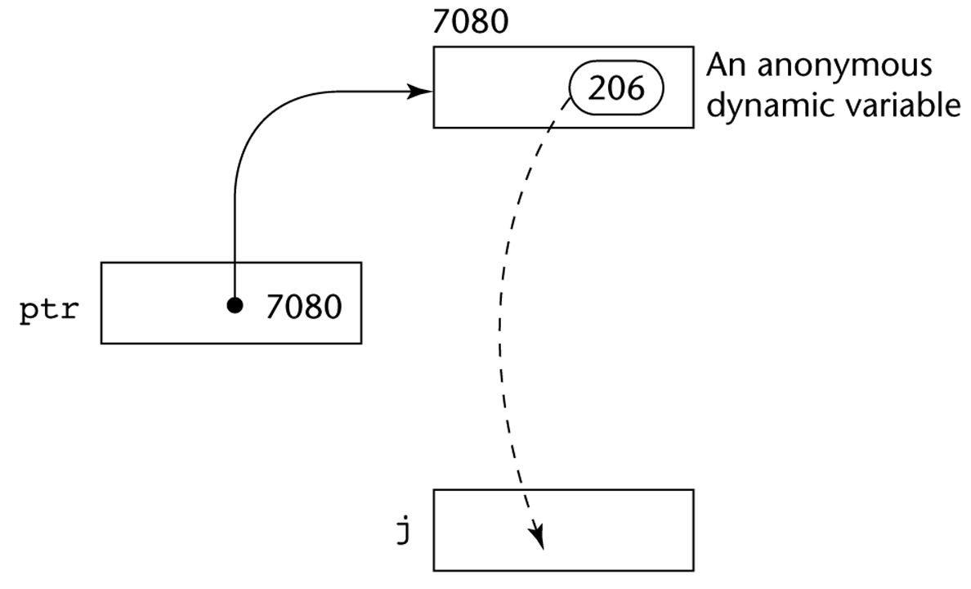
Pointers
The assignment operation j = *ptr

Slide 72
Pointers
Examples (continued):
  4. FORTRAN 90 Pointers
  Can point to heap and non-heap variables
  Implicit dereferencing
  Pointers can only point to variables that have the TARGET attribute
  The TARGET attribute is assigned in the declaration, as in:
  INTEGER, TARGET :: NODE

Slide 73
Pointers
Examples (continued):
  4. FORTRAN 90 Pointers (continued)
  A special assignment operator is used for non-dereferenced references, e.g.:
REAL, POINTER :: ptr (POINTER is an attribute)
ptr => target (where target is either a pointer or a non-pointer with the TARGET attribute)
  This sets ptr to have the same value as target

Slide 74
Pointers
Examples (continued):
  5. C++ Reference Types
  Constant pointers that are implicitly dereferenced
  Used for parameters
    Advantages of both pass-by-reference and pass-by-value

Slide 75
Pointers
Examples (continued):
  6. Java - Only references
  No pointer arithmetic
  Can only point at objects (which are all on the heap)
  No explicit deallocator (garbage collection is used)
  Means there can be no dangling references
  Dereferencing is always implicit

Slide 76
Pointers
Evaluation of pointers:
  1. Dangling pointers and dangling objects are problems, as is heap management
  2. Pointers are like goto's--they widen the range of cells that can be accessed by a variable
  3. Pointers or references are necessary for dynamic data structures--so we can't design a language without them

Slide 77
Pointers
Representation of pointers and references
  Large computers use single values
  Intel microprocessors use segment and offset
Dangling pointer problem
  1. Tombstone: extra heap cell that is a pointer to the heap-dynamic variable
  The actual pointer variable points only at tombstones
  When heap-dynamic variable deallocated, tombstone remains but set to nil

Slide 78
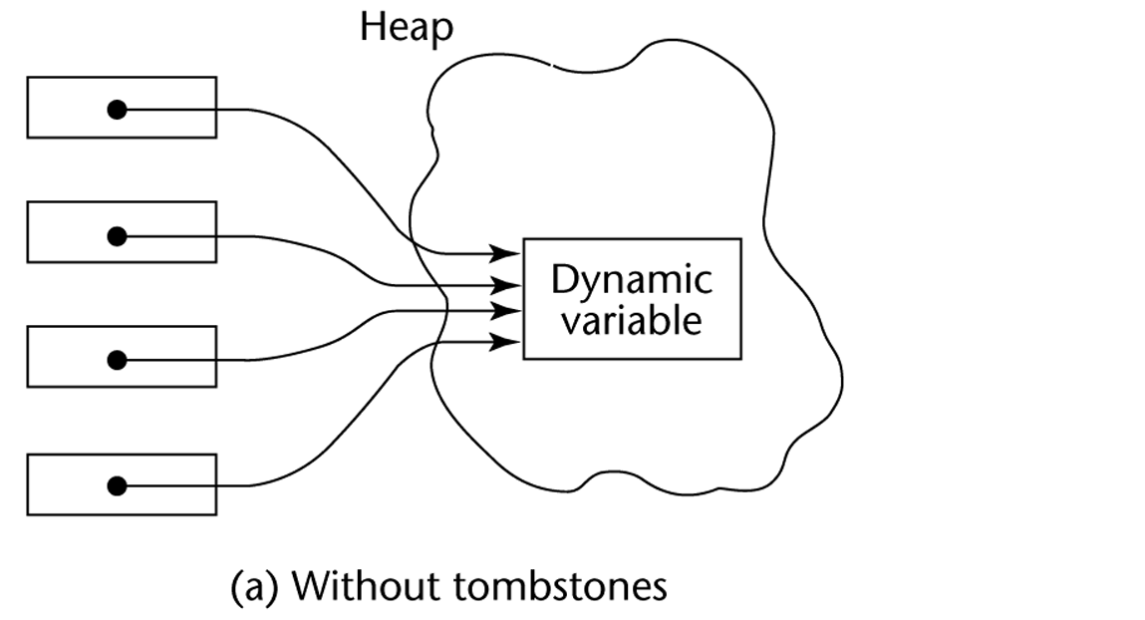
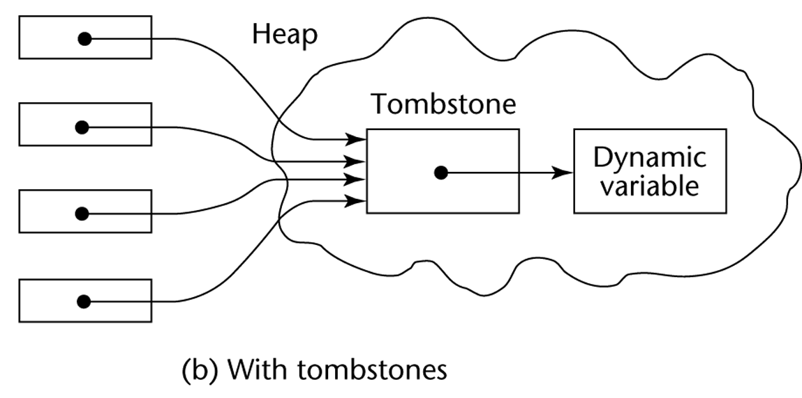
Implementing Dynamic Variables

Slide 79
Pointers
Dangling pointer problem (continued)
  2. Locks and keys: Pointer values are represented as (key, address) pairs
  Heap-dynamic variables are represented as variable plus cell for integer lock value
  When heap-dynamic variable allocated, lock value is created and placed in lock cell and key cell of pointer

Slide 80
Pointers
Heap management
  Single-size cells vs. variable-size cells
  Reference counters (eager approach) vs. garbage collection (lazy approach)
  1. Reference counters: maintain a counter in every cell that store the number of pointers currently pointing at the cell
  Disadvantages: space required, execution time required, complications for cells connected circularly

Slide 81
Pointers
Heap management
  2. Garbage collection: allocate and disconnect until all available cells allocated; then begin gathering all garbage
  Every heap cell has an extra bit used by collection algorithm
  All cells initially set to garbage
  All pointers traced into heap, and reachable cells marked as not garbage
  All garbage cells returned to list of available cells

Slide 82
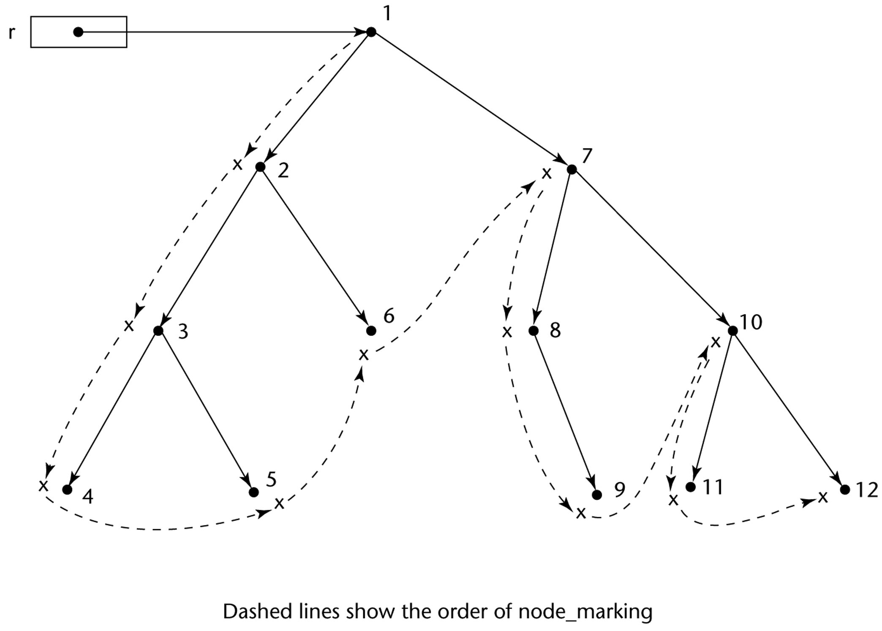
Marking Algorithm

Slide 83
Pointers
Heap management (continued)
  2. Garbage collection (continued):
  Disadvantages: when you need it most, it works worst (takes most time when program needs most of cells in heap)

